Slide 1
Managing Information Technology Resources ITWS 4310
Netflix Case
October 9, 2018

Slide 2
Managing IT Resources Class Outline: Tues, Oct 9, 2018
MITR Term Project
Schedule Meetings with Client and Invite Faculty to Meetings
Work on “System Requirements” with Client due as part of “Initial Sections” tonight by 9 PM
Work on “Risk Management Plan” due as part of “Initial Sections” tonight by 9 PM
Submit updated “CBA” due as part of “Initial Sections” tonight by 9 PM
“Initial Sections” for Project Due tonight by 9:00 PM
Mid-Term Exam on Monday Oct 15 during class from 10 AM – 11:50 AM
Exam will be in Lally 102
See past Mid-Term Exams posted on LMS
Note: Final Exam schedule is out
Wednesday December 19 from 11:30 AM – 2:30 PM
Location TBD
Network Effects
Current Events
Netflix Case

Slide 3
Managing IT Resources: ITWS 4310 Term Project Report Outline
Improve based on assignment feedback
Update based on new information
Add “requirements”
Add “risk management” as part of CBA section
Integrate and make flow as sections of one document
Section 1: Executive Summary
Section 2: Introduction
Section 3: Client Organization and Description
Section 4: Project Team
Section 5: Problem Statement
Section 6: IS/IT Solution
Section 7: Methodology
Section 8: IS/IT Requirements
Section 9: IS/IT Design
Section 10: Cost-Benefit Analysis with (Risk Mgmt)
Section 11: Project Plan/Schedule/Resources
Section 12: Post-Turnover Plan
Section 13: Results and Client Feedback
Section 14: Conclusions
Project Proposal:
Requirements
Cost-Benefit Analysis
Project Plan

Slide 4
Technology Current Events: “New GE CEO Larry Culp signs stock-heavy contract worth up to $300 million if shares soar”, CNBC, Oct 5, 2018 https://www.cnbc.com/2018/10/05/new-ge-ceo-larry-culp-inks-stock-heavy-contract-worth-up-to-300-million-if-shares-soar.html
General Electric is in dire need of a turnaround. It will pay its new CEO handsomely if he can pull one off.
Larry Culp, named GE chairman and CEO on Monday, will receive a compensation package of up to $21 million a year in salary, bonuses and stock for the next four years. Beginning next year, GE will annually give Culp a salary of $2.5 million, a bonus of about $3.75 million and equity awards valued at $15 million.
But that's not the best part for Culp: If the stock rises more than 50 percent, he also gets a payday of about $47 million. And he gets more money if it rises further.
"If we get up 150 percent, we're talking $300 million," David Faber, who reported details of the contract, noted on CNBC's "Squawk on the Street" on Friday.
The one-time pay out at the end of the third quarter in 2022 is based on performance metrics for Culp, marked by increases in GE stock.
If the company's stock rises 50 percent, Culp gets 2.5 million GE shares at about $18.60 a share – or about $47 million. If the company's stock rises 150 percent, Culp gets 7.5 million shares at $31 a share – or about $233 million. Added to his annual pay and awards, Culp could bring in as much as $317 million.

Slide 5
Technology Current Events: “Facebook unveils Portal smart speakers with video calling to battle Amazon and Google”, CNBC, Oct 8, 2018 https://www.cnbc.com/2018/10/08/facebook-portal-smart-speakers-battle-amazon-echo-google-home.html
Facebook on Monday unveiled a pair of smart speakers, complete with cameras and microphones, for your home.
The devices, Portal and Portal+, directly challenge Amazon, Googleand Apple in the fast-growing smart-speaker market with a unique approach that will emphasize video calling. It's Facebook's first hardware product outside the Oculus line of virtual-reality devices.
To start a video call, users can say "Hey Portal, call ..." followed by the name of a connection on Facebook's Messenger service.
These calls include entertaining augmented-reality features that can outfit users with cat hats or turn their living rooms into animated night clubs.
Another feature is Smart Camera, which uses artificial intelligence and the devices' cameras to perfectly frame users on video as they move around while on a call.
"Portal+ and Portal really live up to that idea of helping you feel closer and allowing you to spend more quality time with people, even if they live thousands of miles away from you," said Dave Kaufman, marketing lead for Facebook's Portal division.

Slide 6
Technology Current Events: “Tesla Is Looking for a Manager to Handle Elon Musk”, Bloomberg, Oct 8, 2018 https://www.bloomberg.com/news/articles/2018-10-08/the-hunt-is-on-for-a-musk-manager-as-tesla-accommodates-the-sec
Wanted: A seasoned executive with a steady hand, a passion for electric cars and the mettle to rein in a CEO with itchy Twitter fingers.
That’s pretty much the job posting Tesla Inc. agreed to as part of the settlement nine days ago with the U.S. Securities and Exchange Commission, which requires the company to appoint an independent chairman to replace Elon Musk and add two directors to the board. Names being floated as candidates for the chairmanship have ranged from former Vice President Al Gore to one-time CEOs including Jim McNerney of Boeing Co. and Alan Mulally of Ford Motor Co.
What shareholders want, of course, is someone who can put Tesla on the path to profitability and also manage Musk, whose tweets about having secured the funding and investor support to take the company private was what got him into hot water with the SEC -- and who, not incidentally, was busy on Twitter last week taunting the agency. The Sept. 29 settlement will keep him out of the top board seat for three years.
This is what some institutional investors have long been calling for, contending that the board has failed to sufficiently govern the chief executive officer and that Musk may be stretched too thin, running Tesla as well as the rocket manufacturer SpaceX, where he’s also both CEO and chairman.

Slide 7

Business Case: Netflix in Two Acts: Sustaining Leadership in an Epic Shift from Atoms to Bits

Slide 8
What are key points in Netflix history?

Slide 9
What are key points in Netflix history?
Founded in 1997
Started as a DVD rental business
Went Public in 2002
Rightly surmised that digital streaming is the future
Starts streaming in 2008
Attempting to maintain industry dominance even as technology fundamentally restructures the dynamics of the business.
Split in 2011 of DVD rental and streaming is a disaster
Netflix is the largest subscription streaming service.
Netflix streaming is available on PCs, tablets, smartphones, Internet-connected TVs, DVD players, video game consoles
Streaming in 190 countries with 100 million subscribers in 2016/2017

Slide 10
How/why did Netflix come to dominate in DVD-by-mail?

Slide 11
How/why did Netflix come to dominate in DVD-by-mail?
Outstanding Customer Service
Fast Service – due to large number of Distribution Centers
Largest selection of Titles (Long-Tail)
Cinematch Recommendation System (Collaborative Filtering)
Largest Customer Base – Economies of Scale
Branding
Brand built on Customer Experience
Early Entry
Excellent Execution

Slide 12
What is the “long-tail” concept? How does it relate to economies of scale and doing business via the internet?

Slide 13
What is the “long-tail” concept? How does it relate to economies of scale and doing business via the internet?
Netflix’s advantage came from the scale of the firm’s selection.
Long tail: Large selection of content beneficial for Internet retailers.
Selection attracts customers.
The internet allows large-selection inventory efficiencies that offline firms can’t match.
Netflix offers its customers over 125,000 titles
Traditional retailers offer about 3,000 titles – because of shelf space constraints
Long tail: A phenomenon whereby firms can make money by offering a near-limitless selection
The long tail works because:
Cost of production and distribution drop
It gives the firm a selection advantage that traditional stores cannot match
Geographic constraints go away and untapped markets open up

Slide 14
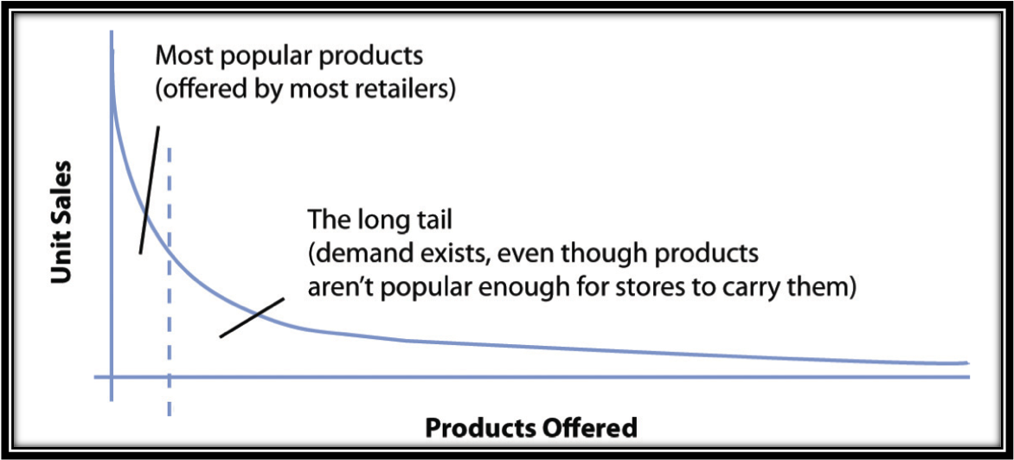
The Long Tail

Slide 15
What is “collaborative filtering”? How did it provide a competitive advantage to Netflix?

Slide 16
Cinematch: Technology Creates a Data Asset that Delivers Profits
Netflix uses a proprietary recommendation system called Cinematch
Each time a DVD is returned, Cinematch asks the customer to rate it
Collaborative filtering: A classification of software that monitors trends among customers and uses this data to personalize an individual customer’s experience
It can be mimicked by competitors

Slide 17
Cinematch: Technology Creates a Data Asset that Delivers Profits
The data provided by Cinematch becomes a switching cost
To see how strong switching costs are, examine Netflix’s churn rate
Churn rate: The rate at which customers leave a product or service
Churn rates for Netflix’s most active regions were below 4 percent
Netflix’s marketing costs benefit from satisfied customers, as referrals are a better choice than advertisements

Slide 18
What are ways in which Netflix has focused on their customer relationships?

Slide 19
What are ways in which Netflix has focused on their customer relationships?
Building a great brand online starts with offering exceptional value
Advertising builds awareness, but brands are built through customer experience
Subscribers expectations from Netflix:
Huge selection
Ability to find what they want
Timely arrival
Ease of use and convenience
Fair price

Slide 20
What are ways in which Netflix has focused on their customer relationships?
Network effects: When the value of a product or service increases as its number of users expands
Metcalfe’s Law: The value of the network is proportional to the square of the number of users
Switching costs: Exist when consumers incur an expense to move from one product or service to another
Sources of switching costs:
Training, Financial Commitments, Search, Loyalty
Data can be a particularly strong switching cost for firms leveraging technology

Slide 21
How does the shift from atoms to bits present both advantages and disadvantages for Netflix?

Slide 22
Atoms to Bits
The shift from physical to digital
In the case of Netflix, the shift from DVD-by-mail to the streaming business poses new challenges:
Content availability
Content acquisition costs
The legal and regulatory environment
Potential revenue opportunities
Potential partners
Competitors and their motivation

Slide 23
Netflix and the Shift from Mailing Atoms to Streaming Bits
When the DVD dies, Netflix’s high-tech shipping and handling infrastructure will be rendered worthless
Advantages of the atoms to bits model
Netflix will eliminate the bulk of its shipping and handling costs
Bandwidth costs are minimal
Disadvantages of the atoms to bits model
Wrangling licensing costs is a challenge
Dependencies on ISP infrastructure reliability and BW
Bandwidth caps: Places a ceiling on a customer’s total monthly consumption

Slide 24
Streaming and the Data Asset
User data is used to:
Make accurate recommendations.
Improve user interface design.
Help the firm determine the appropriate cost for acquiring content.
Shape creative decisions in original program offerings.
Make better content investments.
Inform the original content investments that Netflix is making.
Create ultra-tailored audience promotions.

Slide 25
What is the “Porter Five Forces of Competition” analysis for the “Internet Services” Industry?
Suppliers
Potential
Entrants
Industry
Competitors
Substitutes
Buyers

Slide 26
Suppliers
Users
Content Providers
OEMs of Computers,
Communications Equip
Power of Suppliers is
Low
Competitiveness of Internet Services is Low-Med
Potential
Entrants
Yet unknown
Start-ups
Power of Entrants
is Med
Industry
Competitors
Facebook, Google,
Amazon, Twitter,
LinkedIn
Power of Industry Comp
is Low - Med
Substitutes
Wearable Device SW
Power of Substitutes
is Low - Med
Buyers
Users spend their time
Advertisers
Power of Buyers is Med

Slide 27
A key question raised at the end of the chapter is whether or not Netflix “deserves the hype”. Based on your research of the industry, the competitive landscape, the external forces, and Netflix financials including stock price over the past 5 years, do you think that Netflix is worthy of the high praise? Yes or No. Why? If yes, what must they do in the future to solidify this praise and reach the goals analysts are expecting? If no, what do you believe should be changed to get on track to achieve what analysts expect?

Slide 28
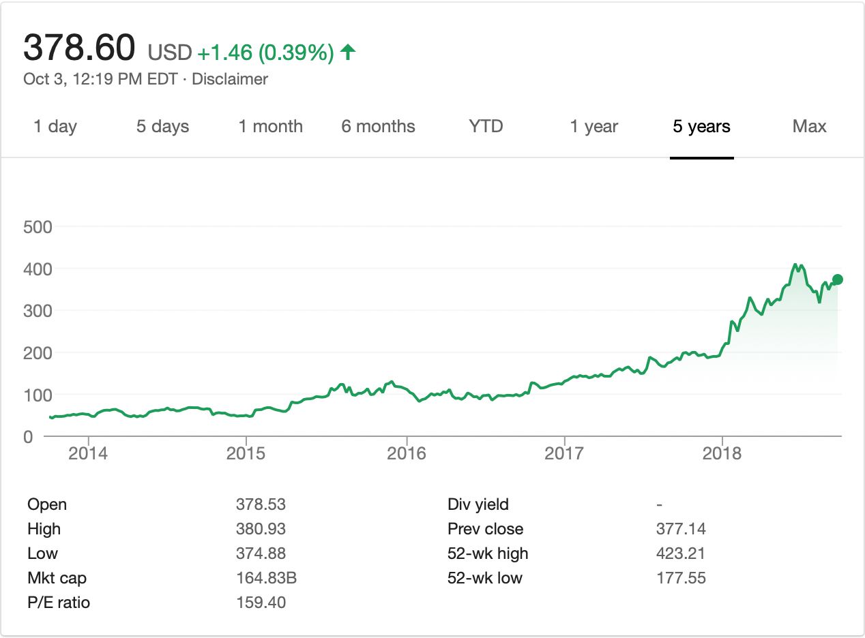
Netflix Stock Price for the Last 5 Years

